Slide 1
Event Orchestration
With State Machines, Mass Transit
December 2023

Slide 2
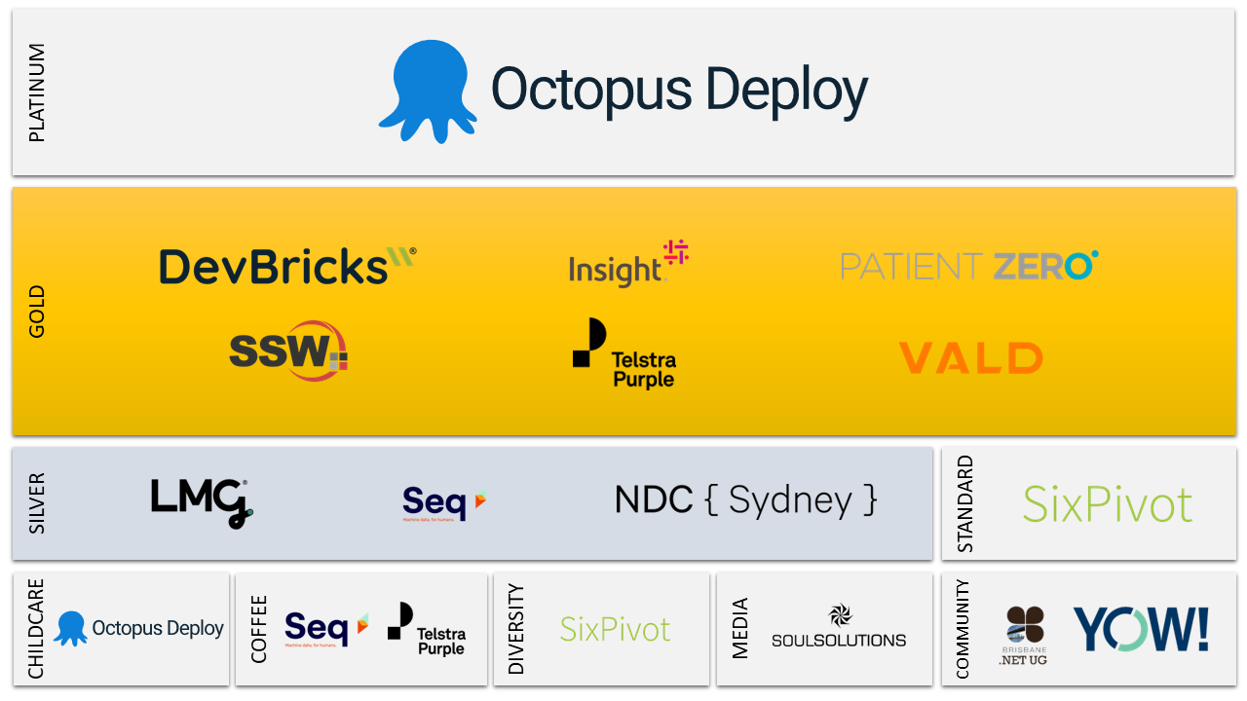

Slide 3
Table Of Contents
Event Driven Concepts
Introducing our Use Case
Mass Transit, Sagas and State Machines
Mass Transit Testing
Persistence and Integration Testing
Deploy to AWS with CDK

Slide 4
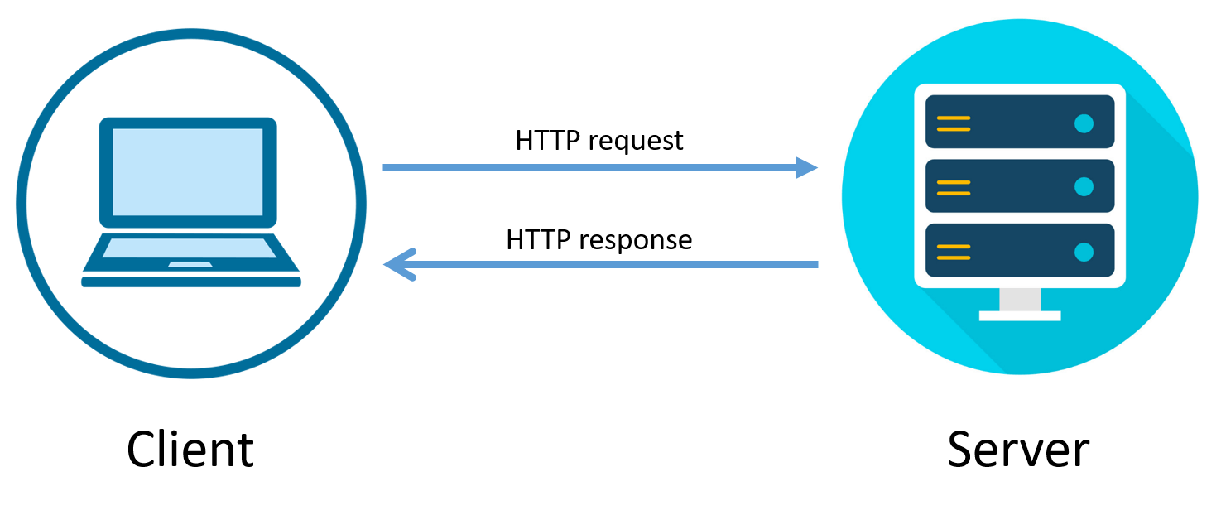
Request - Response Web Servers

Slide 5
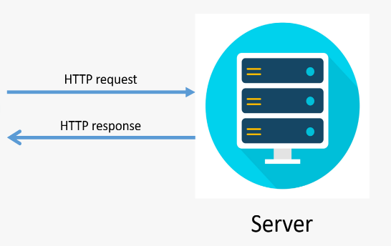
Request - Response Web Servers

Slide 6

Introducing Queues

Slide 7
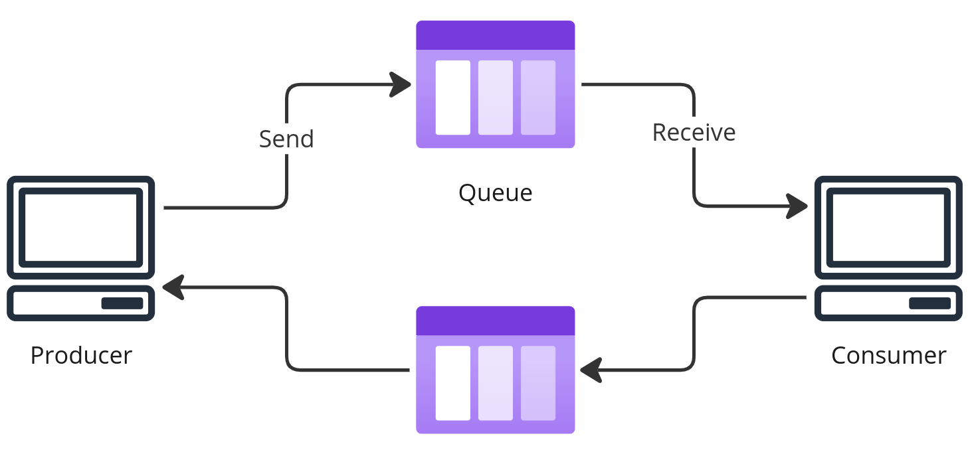
Async Request - Response

Slide 8

Queues Add Resilience
At-least-once guaranteed delivery

Slide 9
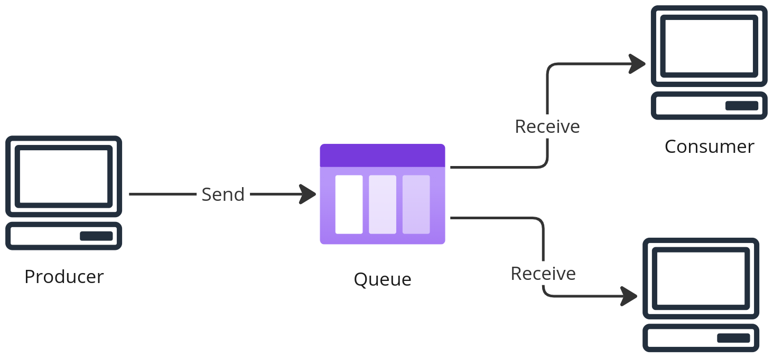
Competing Consumer Pattern

Slide 10


Serverless Compute
Azure Service Bus + Function Apps

Slide 11


Serverless Compute
AWS SQS + Lambda

Slide 12
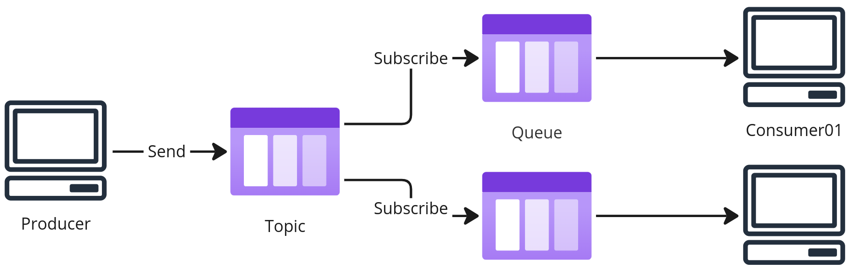
Topics or Pub/Sub

Slide 13
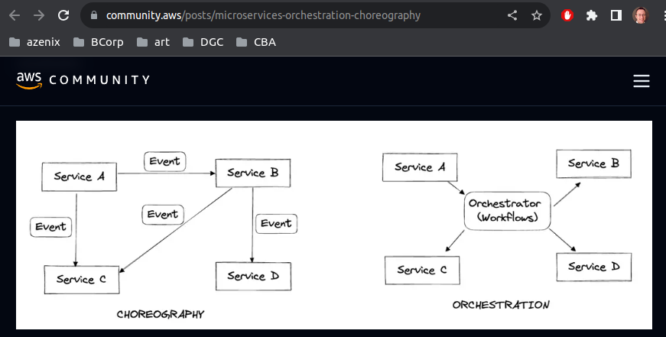

Slide 14
Choreography Vs Orchestration
Choreography
Orchestration
Loosely Coupled
Stateless
Flexible
Difficult Observability
Tightly Coupled
Stateful
Transactional
Easier Observability

Slide 15
Choreography Vs Orchestration
Choreography
Orchestration
Loosely Coupled
Stateless
Flexible
Difficult Observability
Tightly Coupled
Stateful
Transactional
Easier Observability

Slide 16
Orchestrator
aka Saga
async request
Dependency
state
async response

Slide 17
Order Received (no payment details)
Order Received Handler
“Do I have Payment details?”
Enrich Order
Payment Service
Order Received
(with payment details)

Slide 18
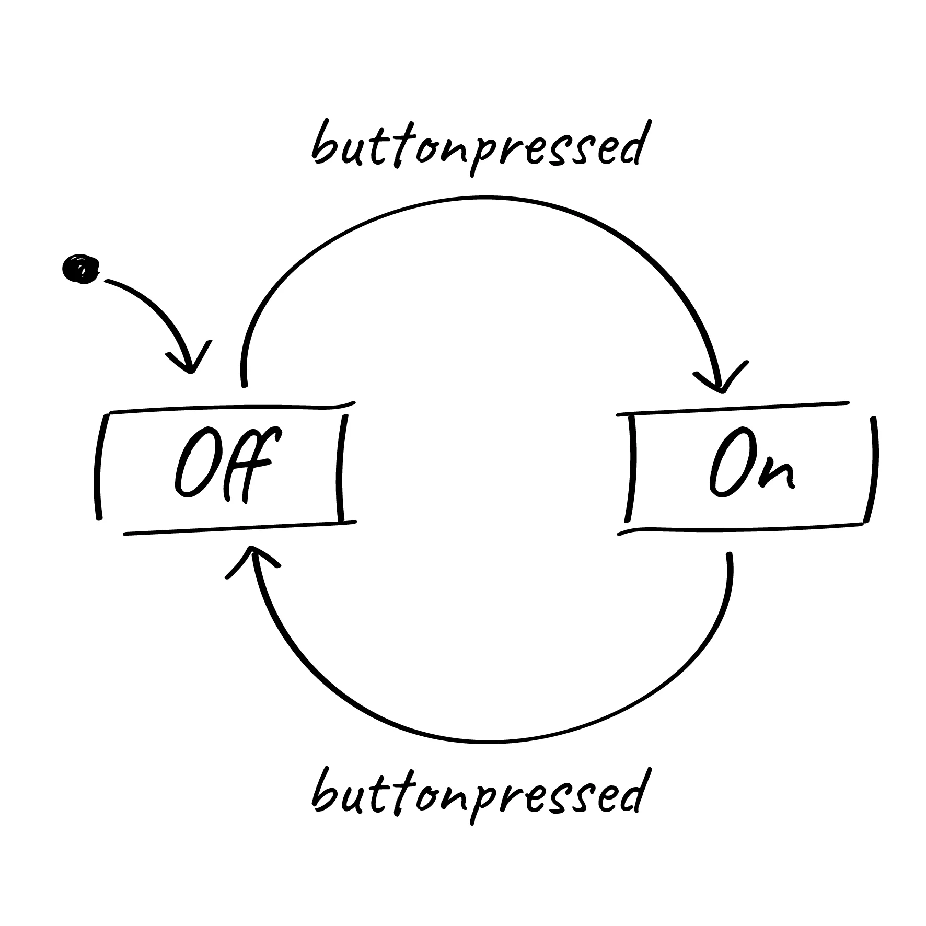

Slide 19
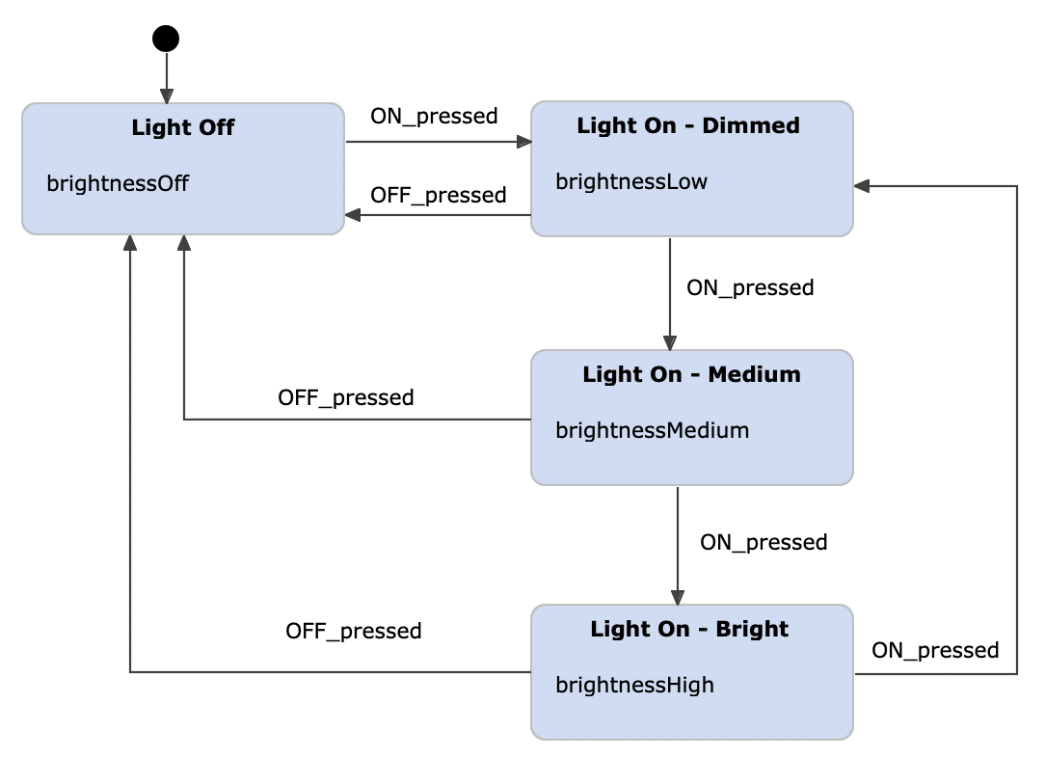

Slide 20
Table Of Contents
Event Driven Concepts
Introducing our Use Case
Mass Transit, Sagas and State Machines
Mass Transit Testing
Persistence and Integration Testing
Deploy to AWS with CDK

Slide 21
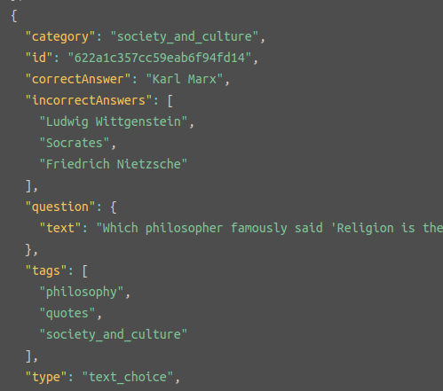

A non-trivial use case
Obviously an online trivia game!
Multiple users
Multiple Choice Trivia Questions
The Trivia API
Assign points based on speed
Stateful
Workflow
Events from multiple sources

Slide 22
Trivia Walkthrough
State: LOBBY OPEN
Create Game
Game Data
CorrelationID
Name

Slide 23
Trivia Walkthrough
State: LOBBY OPEN
Add Participant
Game Data
CorrelationID
Name
Participants[]

Slide 24
Trivia Walkthrough
State: QUESTION OPEN
Start Game
Game Data
CorrelationID
Name
Participants[]
Questions[]
CurrentQuestionNo
Fetch Questions
(Trivia API)
Schedule Close Question

Slide 25
Trivia Walkthrough
State: QUESTION OPEN
Answer Question
Game Data
CorrelationID
Name
Participants[]
Questions[]
CurrentQuestionNo
ParticipantAnswers[]

Slide 26
Trivia Walkthrough
State: QUESTION RESULT
Close Question
Game Data
CorrelationID
Name
Participants[]
Questions[]
CurrentQuestionNo
ParticipantAnswers[]
ParticipantScores[]
Calculate Scores
Schedule Next Question

Slide 27
Trivia Walkthrough
State: QUESTION OPEN
Next Question
Game Data
CorrelationID
Name
Participants[]
Questions[]
CurrentQuestionNo
ParticipantAnswers[]
ParticipantScores[]
Schedule Close Question

Slide 28
Trivia Walkthrough
State: FINAL
Next Question
Game Data
CorrelationID
Name
Participants[]
Questions[]
CurrentQuestionNo
ParticipantAnswers[]
ParticipantScores[]

Slide 29
Table Of Contents
Event Driven Concepts
Introducing our Use Case
Mass Transit, Sagas and State Machines
Mass Transit Testing
Persistence and Integration Testing
Deploy to AWS with CDK

Slide 30
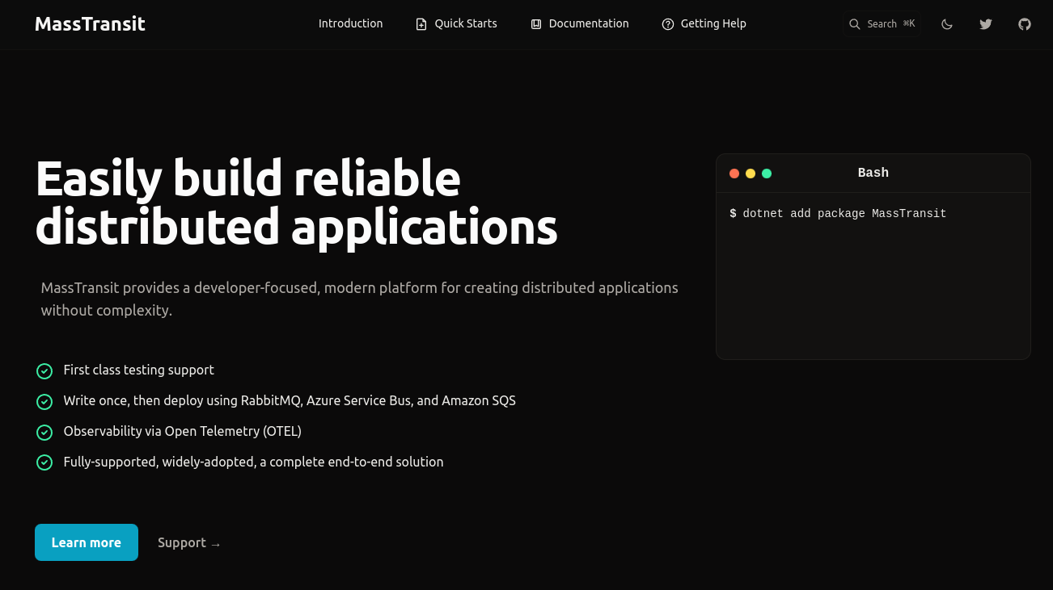

Slide 31








Slide 32
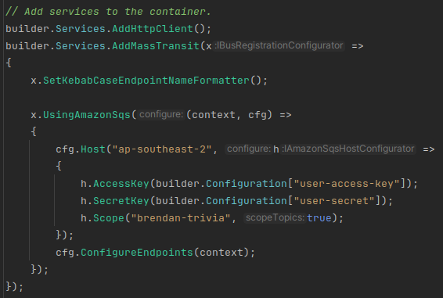
Producers - Config

Slide 33
Producers - Config

Slide 34
Producers - Config

Slide 35
Producers - Config

Slide 36
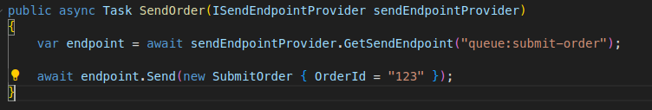
Producers - Send

Slide 37
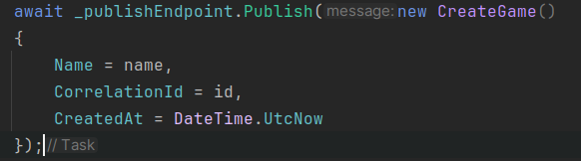
Producers - Publish

Slide 38
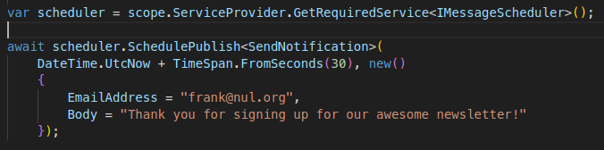
Producers - Schedule

Slide 39
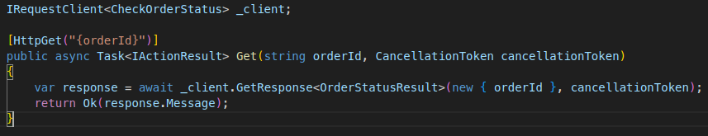
Producers - Request/Response

Slide 40
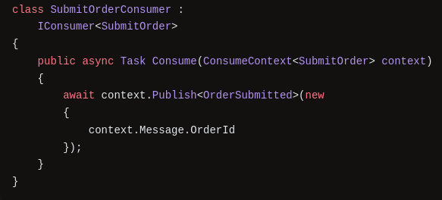
Consumer

Slide 41
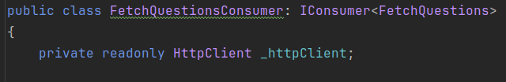
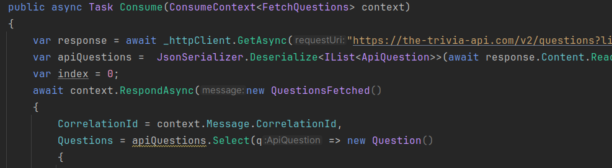
Consumer: Fetch Questions

Slide 42
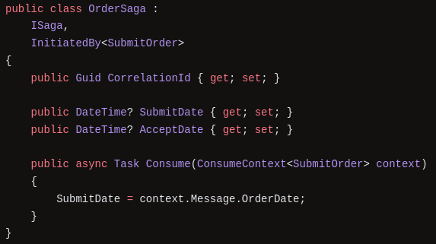
Consumer Saga: Stateful Class, Consumer

Slide 43
Consumer Saga: Stateful Class, Consumer

Slide 44
Consumer Saga: Stateful Class, Consumer

Slide 45
State Machines
QUESTION OPEN
QUESTION ANSWER
CLOSE QUESTION

Slide 46
State Machines
QUESTION OPEN
QUESTION OPEN
QUESTION ANSWER
CLOSE QUESTION
Calculate Scores

Slide 47
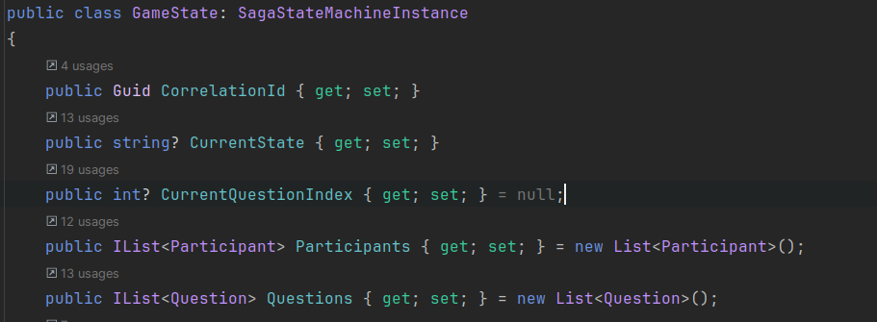
State Machine Saga

Slide 48
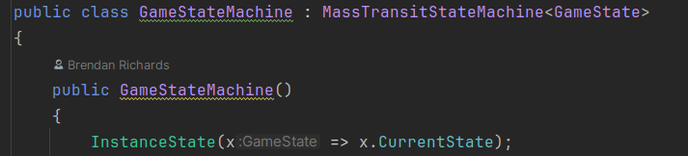
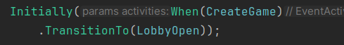
State Machine Saga

Slide 49
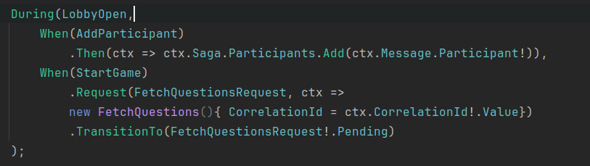
Concise DSL for State Transitions

Slide 50
Concise DSL for State Transitions
State

Slide 51
Concise DSL for State Transitions
Event

Slide 52
Concise DSL for State Transitions
.Then
Do something locally

Slide 53
Concise DSL for State Transitions
.Request
Raise async req/response

Slide 54
Concise DSL for State Transitions
.TransitionTo
Target State

Slide 55
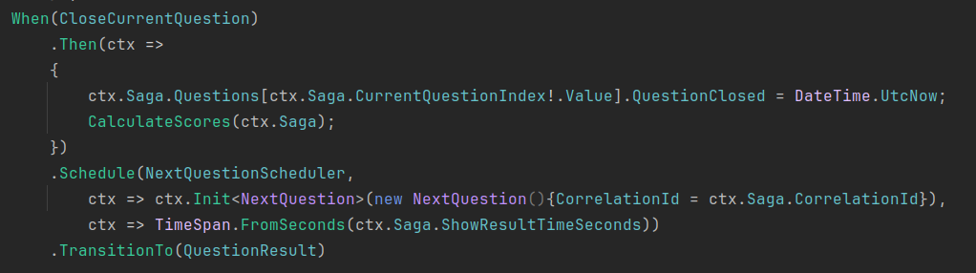
Concise DSL for State Transitions
.Schedule
Schedule a future event

Slide 56
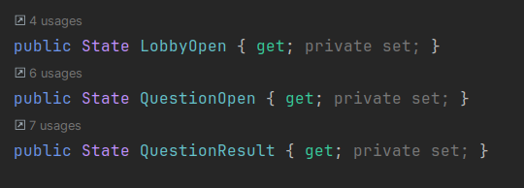
Declare Items to use in State Machine

Slide 57
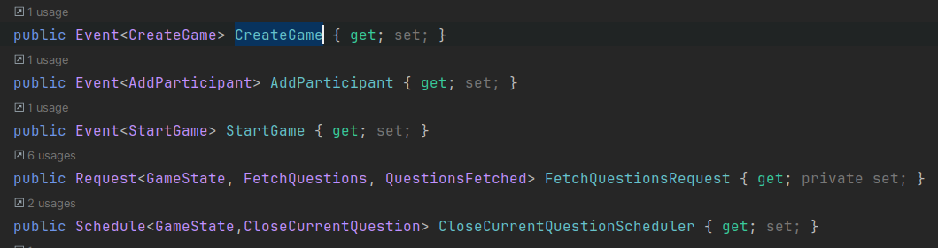
Declare Items to use in State Machine

Slide 58
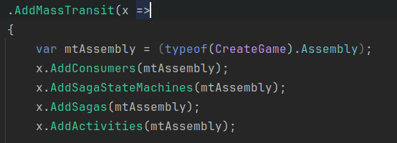
Container Config - Assembly Scan

Slide 59
Table Of Contents
Event Driven Concepts
Introducing our Use Case
Mass Transit, Sagas and State Machines
Mass Transit Testing
Persistence and Integration Testing
Deploy to AWS with CDK

Slide 60
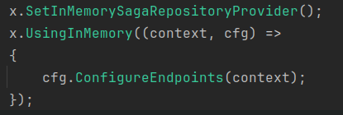
In Memory Providers

Slide 61
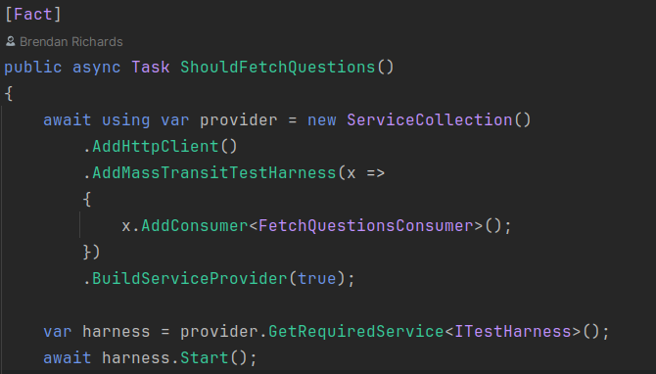
Mass Transit Test Harness

Slide 62
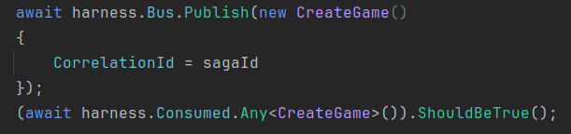
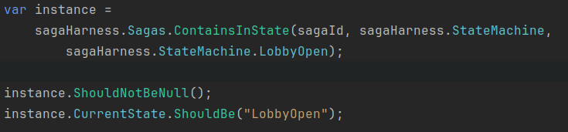
Test Harness - retrieve state

Slide 63
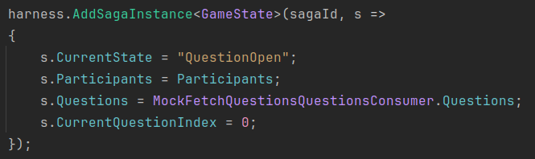
Saga - Custom Initial State

Slide 64
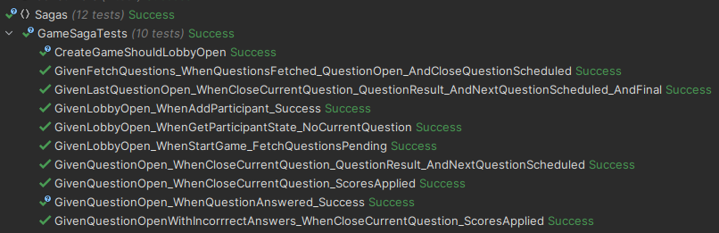
Test our whole game engine

Slide 65
Table Of Contents
Event Driven Concepts
Introducing our Use Case
Mass Transit, Sagas and State Machines
Mass Transit Testing
Persistence and Integration Testing
Deploy to AWS with CDK

Slide 66











Slide 67


Slide 68
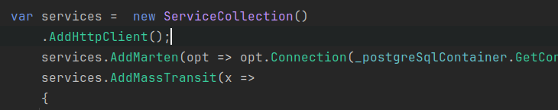
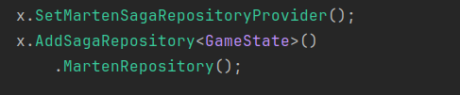
Configure Marten

Slide 69
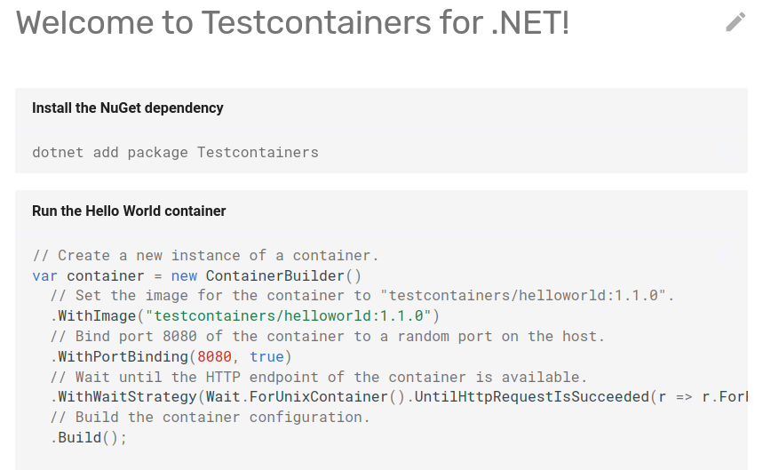
Configure Marten

Slide 70



Slide 71


Slide 72
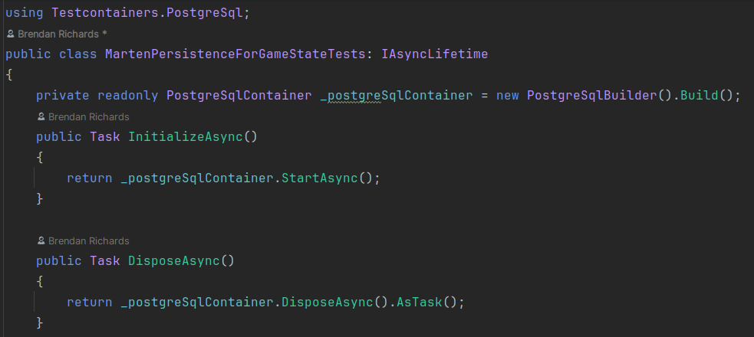
PosgreSqlContainer

Slide 73
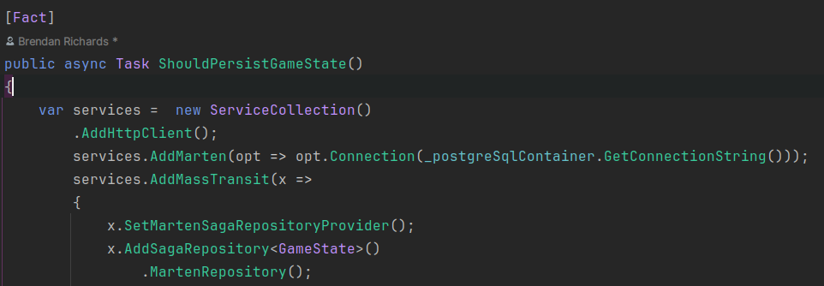
Arrange

Slide 74
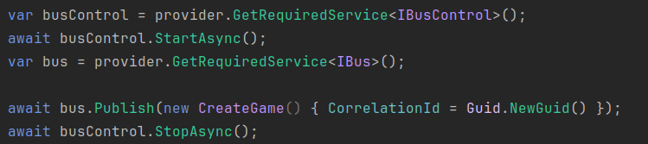
Act

Slide 75
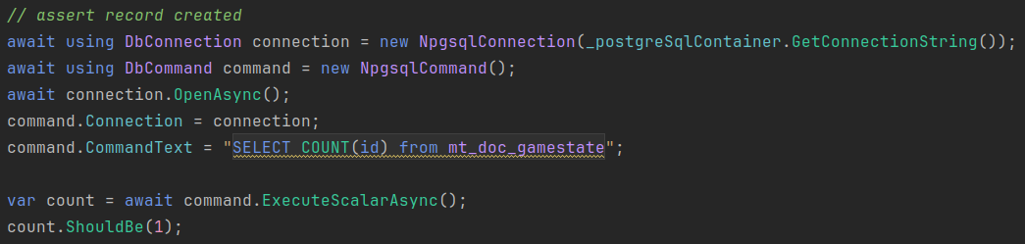
Assert

Slide 76
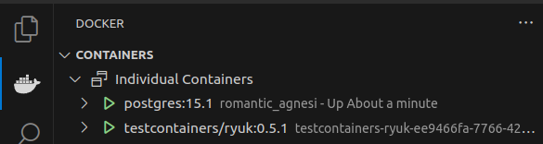
Test Containers

Slide 77
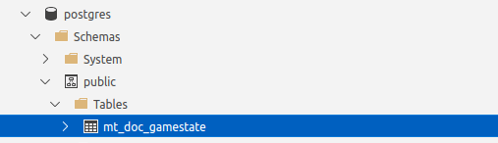
Postgres DB - Azure Data Studio

Slide 78
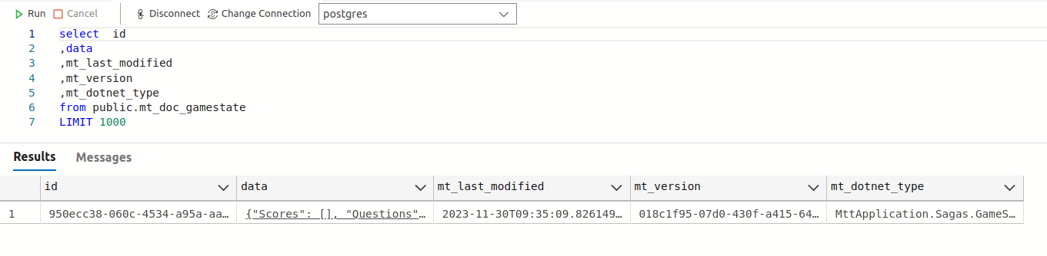
Postgres DB - Azure Data Studio

Slide 79
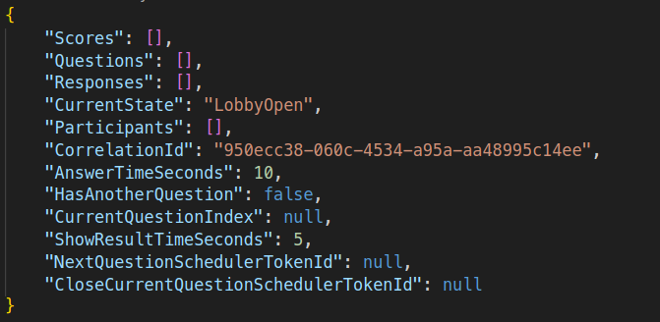
Persisted Gamestate Json

Slide 80
Mass Transit Recap
Library for working with async messaging
Consumers
Send, Publish, Schedule, Request
Sagas
Stateful - Correlation ID
Orchestrate multiple consumers
State Machine Sagas
Add State Machine workflow syntax
Saga Caveats
Load and save full state with every message handled
Contention on parallel executions
Add Participant and Question Response

Slide 81
Table Of Contents
Event Driven Concepts
Introducing our Use Case
Mass Transit, Sagas and State Machines
Mass Transit Testing
Persistence and Integration Testing
Deploy to AWS with CDK

Slide 82
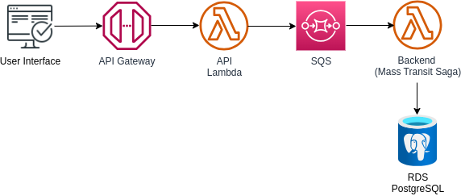
Architecture

Slide 83
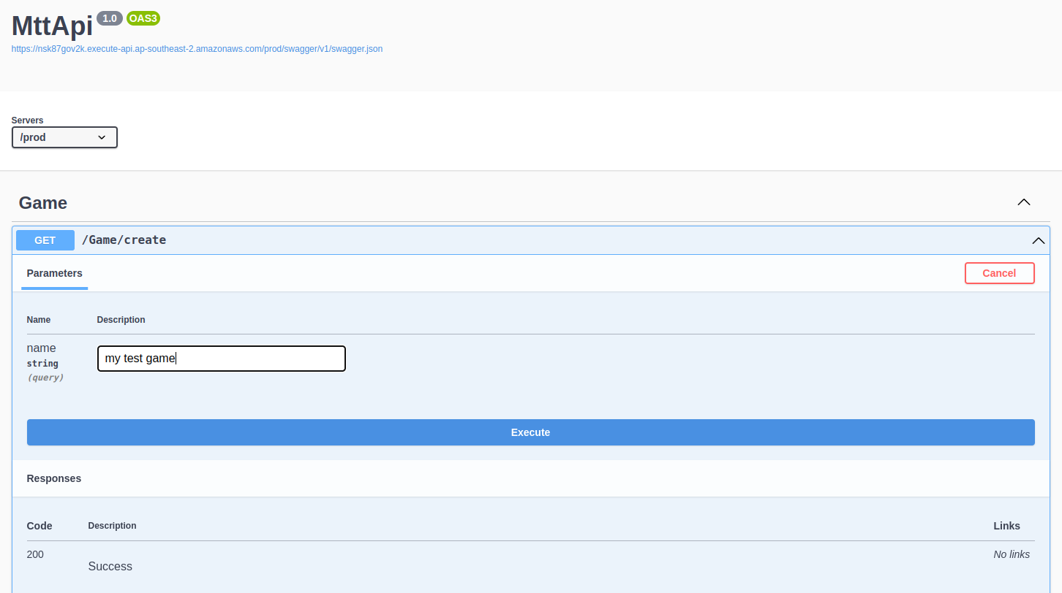
Open Api / Swagger

Slide 84
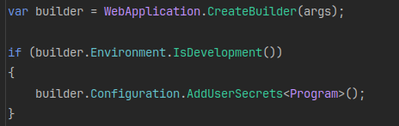
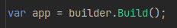
Asp.NET Core Web Application

Slide 85
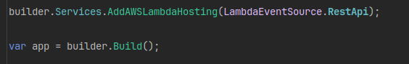
AddAWSLamdbaHosting

Slide 86

Configure Services

Slide 87

Configure HTTP Pipeline

Slide 88

MVC Controller Class

Slide 89

Create Game

Slide 90
Infra-as-code Options
CloudFormation
Terraform
CDK - Cloud Development Kit
Write code in your language
Compile to CF stack and deploy

Slide 91

CDK - .NET Lambda

Slide 92

.NET Lambda Bundling Options

Slide 93

Permissions

Slide 94

API Gateway

Slide 95
CDK Deploy

Slide 96
Architecture

Slide 97
Mass Transit Easy Path
Mass Transit will create Topics, Queues and Subscriptions
Server
.NET
Mass Transit
Transport
Queues

Slide 98
Mass Transit + Serverless
Need to be deployed with the infra.
Short-Lived Function
Binding / Event Source
.NET
Transport
Queues
Mass Transit

Slide 99


Deploy Topology Only

Slide 100


Slide 101



Slide 102


Slide 103

CDK - Reference existing Queue

Slide 104


Lambda Receive Message

Slide 105

Lambda Receive Message

Slide 106
Lambda Receive Message

Slide 107
Table Of Contents
Event Driven Concepts
Introducing our Use Case
Mass Transit, Sagas and State Machines
Mass Transit Testing
Persistence and Integration Testing
Deploy to AWS with CDK

Slide 108



Slide 110


Slide 112
Presentation template
Add client logo here. Set the height of the logo to the same height as this rectangle. Please remove rectangle once done.
Mantel Group base template
August 2023

Slide 113
Presentation template
Mantel Group base template
August 2023

Slide 115
Layouts for presentation
With Mantel Group logo and tagline

Slide 116
Single row heading
Awesome subheading
Marshmallow roll sweet roll topping shortbread toffee. Chocolate bar marshmallow sweet chocolate carrot cake. Croissant cake caramels gummi bears icing. Powder brownie ice cream candy donut liquorice muffin jelly marshmallow roll. Jelly fruitcake donut chupa chups jujubes. Muffin marshmallow roll pudding caramels biscuit pudding.

Slide 117
Heading spanning over two rows
Awesome subheading
Marshmallow roll sweet roll topping shortbread toffee. Chocolate bar marshmallow sweet chocolate carrot cake. Croissant cake caramels gummi bears icing. Powder brownie ice cream candy donut liquorice muffin jelly marshmallow roll. Jelly fruitcake donut chupa chups jujubes. Muffin marshmallow roll pudding caramels biscuit pudding.

Slide 118
Single row heading
Awesome subheading
Caption
Marshmallow roll sweet roll topping shortbread toffee. Chocolate bar marshmallow sweet chocolate carrot cake. Croissant cake caramels gummi bears icing. Powder brownie ice cream candy donut liquorice muffin jelly marshmallow roll. Jelly fruitcake donut chupa chups jujubes. Muffin marshmallow roll pudding caramels biscuit pudding.

Slide 119
Heading spanning over two rows
Awesome subheading
Caption
Marshmallow roll sweet roll topping shortbread toffee. Chocolate bar marshmallow sweet chocolate carrot cake. Croissant cake caramels gummi bears icing. Powder brownie ice cream candy donut liquorice muffin jelly marshmallow roll. Jelly fruitcake donut chupa chups jujubes. Muffin marshmallow roll pudding caramels biscuit pudding.

Slide 120
Single row heading
Awesome subheading
Marshmallow roll sweet roll topping shortbread toffee. Chocolate bar marshmallow sweet chocolate carrot cake. Croissant cake caramels gummi bears icing. Powder brownie ice cream candy donut liquorice muffin jelly marshmallow roll.

Slide 121
Heading spanning over two rows
Awesome subheading
Marshmallow roll sweet roll topping shortbread toffee. Chocolate bar marshmallow sweet chocolate carrot cake. Croissant cake caramels gummi bears icing. Powder brownie ice cream candy donut liquorice muffin jelly marshmallow roll.

Slide 122
Single row heading
Awesome subheading
Caption
Marshmallow roll sweet roll topping shortbread toffee. Chocolate bar marshmallow sweet chocolate carrot cake. Croissant cake caramels gummi bears icing. Powder brownie ice cream candy donut liquorice muffin jelly marshmallow roll.

Slide 123
Heading spanning over two rows
Awesome subheading
Caption
Marshmallow roll sweet roll topping shortbread toffee. Chocolate bar marshmallow sweet chocolate carrot cake. Croissant cake caramels gummi bears icing. Powder brownie ice cream candy donut liquorice muffin jelly marshmallow roll.

Slide 124
Single row heading
Awesome subheading
Marshmallow roll sweet roll topping shortbread toffee. Chocolate bar marshmallow sweet chocolate carrot cake. Croissant cake caramels gummi bears icing. Powder brownie ice cream candy donut liquorice muffin jelly marshmallow roll.
Caption
Croissant cake caramels gummi bears icing. Powder brownie ice cream candy donut liquorice muffin jelly marshmallow roll. Jelly fruitcake donut chupa chups jujubes. Muffin marshmallow roll pudding caramels biscuit. Pudding muffin ice cream carrot cake jelly jelly-o toffee.

Slide 125
Heading spanning over two rows
Awesome subheading
Marshmallow roll sweet roll topping shortbread toffee. Chocolate bar marshmallow sweet chocolate carrot cake. Croissant cake caramels gummi bears icing. Powder brownie ice cream candy donut liquorice muffin jelly marshmallow roll.
Caption
Croissant cake caramels gummi bears icing. Powder brownie ice cream candy donut liquorice muffin jelly marshmallow roll. Jelly fruitcake donut chupa chups jujubes. Muffin marshmallow roll pudding caramels biscuit. Pudding muffin ice cream carrot cake jelly jelly-o toffee.

Slide 126
Single row heading
Awesome subheading
Caption
Caption
Caption
Marshmallow roll sweet roll topping shortbread toffee. Chocolate bar marshmallow sweet chocolate carrot cake. Croissant cake.
Marshmallow roll sweet roll topping shortbread toffee. Chocolate bar marshmallow sweet chocolate carrot cake. Croissant cake.
Marshmallow roll sweet roll topping shortbread toffee. Chocolate bar marshmallow sweet chocolate carrot cake. Croissant cake.

Slide 127
Heading spanning over two rows
Awesome subheading
Caption
Caption
Caption
Marshmallow roll sweet roll topping shortbread toffee. Chocolate bar marshmallow sweet chocolate carrot cake. Croissant cake.
Marshmallow roll sweet roll topping shortbread toffee. Chocolate bar marshmallow sweet chocolate carrot cake. Croissant cake.
Marshmallow roll sweet roll topping shortbread toffee. Chocolate bar marshmallow sweet chocolate carrot cake. Croissant cake.

Slide 128
Single row heading
Awesome subheading
Marshmallow roll sweet roll topping shortbread toffee. Chocolate bar marshmallow sweet.
Marshmallow roll sweet roll topping shortbread toffee. Chocolate bar marshmallow sweet.
Marshmallow roll sweet roll topping shortbread toffee. Chocolate bar marshmallow sweet.

Slide 129
Heading spanning over two rows
Awesome subheading
Marshmallow roll sweet roll topping shortbread toffee. Chocolate bar marshmallow sweet.
Marshmallow roll sweet roll topping shortbread toffee. Chocolate bar marshmallow sweet.
Marshmallow roll sweet roll topping shortbread toffee. Chocolate bar marshmallow sweet.

Slide 130
Single row heading
Awesome subheading
Caption
Caption
Caption
Marshmallow roll sweet roll topping shortbread toffee. Chocolate bar.
Marshmallow roll sweet roll topping shortbread toffee. Chocolate bar.
Marshmallow roll sweet roll topping shortbread toffee. Chocolate bar.

Slide 131
Heading spanning over two rows
Awesome subheading
Caption
Caption
Caption
Marshmallow roll sweet roll topping shortbread toffee. Chocolate bar.
Marshmallow roll sweet roll topping shortbread toffee. Chocolate bar.
Marshmallow roll sweet roll topping shortbread toffee. Chocolate bar.

Slide 132
Single row heading
Awesome subheading

Slide 133
Layouts for presentation
Without Mantel Group logo and tagline

Slide 134
Single row heading
Awesome subheading
Marshmallow roll sweet roll topping shortbread toffee. Chocolate bar marshmallow sweet chocolate carrot cake. Croissant cake caramels gummi bears icing. Powder brownie ice cream candy donut liquorice muffin jelly marshmallow roll. Jelly fruitcake donut chupa chups jujubes. Muffin marshmallow roll pudding caramels biscuit pudding.

Slide 135
Heading spanning over two rows
Awesome subheading
Marshmallow roll sweet roll topping shortbread toffee. Chocolate bar marshmallow sweet chocolate carrot cake. Croissant cake caramels gummi bears icing. Powder brownie ice cream candy donut liquorice muffin jelly marshmallow roll. Jelly fruitcake donut chupa chups jujubes. Muffin marshmallow roll pudding caramels biscuit pudding.

Slide 136
Single row heading
Awesome subheading
Caption
Marshmallow roll sweet roll topping shortbread toffee. Chocolate bar marshmallow sweet chocolate carrot cake. Croissant cake caramels gummi bears icing. Powder brownie ice cream candy donut liquorice muffin jelly marshmallow roll. Jelly fruitcake donut chupa chups jujubes. Muffin marshmallow roll pudding caramels biscuit pudding.

Slide 137
Heading spanning over two rows
Awesome subheading
Caption
Marshmallow roll sweet roll topping shortbread toffee. Chocolate bar marshmallow sweet chocolate carrot cake. Croissant cake caramels gummi bears icing. Powder brownie ice cream candy donut liquorice muffin jelly marshmallow roll. Jelly fruitcake donut chupa chups jujubes. Muffin marshmallow roll pudding caramels biscuit pudding.

Slide 138
Single row heading
Awesome subheading
Marshmallow roll sweet roll topping shortbread toffee. Chocolate bar marshmallow sweet chocolate carrot cake. Croissant cake caramels gummi bears icing. Powder brownie ice cream candy donut liquorice muffin jelly marshmallow roll.

Slide 139
Heading spanning over two rows
Awesome subheading
Marshmallow roll sweet roll topping shortbread toffee. Chocolate bar marshmallow sweet chocolate carrot cake. Croissant cake caramels gummi bears icing. Powder brownie ice cream candy donut liquorice muffin jelly marshmallow roll.

Slide 140
Single row heading
Awesome subheading
Caption
Marshmallow roll sweet roll topping shortbread toffee. Chocolate bar marshmallow sweet chocolate carrot cake. Croissant cake caramels gummi bears icing. Powder brownie ice cream candy donut liquorice muffin jelly marshmallow roll.

Slide 141
Heading spanning two rows
Awesome subheading
Caption
Marshmallow roll sweet roll topping shortbread toffee. Chocolate bar marshmallow sweet chocolate carrot cake. Croissant cake caramels gummi bears icing. Powder brownie ice cream candy donut liquorice muffin jelly marshmallow roll.

Slide 142
Single row heading
Awesome subheading
Marshmallow roll sweet roll topping shortbread toffee. Chocolate bar marshmallow sweet chocolate carrot cake. Croissant cake caramels gummi bears icing. Powder brownie ice cream candy donut liquorice muffin jelly marshmallow roll.
Caption
Croissant cake caramels gummi bears icing. Powder brownie ice cream candy donut liquorice muffin jelly marshmallow roll. Jelly fruitcake donut chupa chups jujubes. Muffin marshmallow roll pudding caramels biscuit. Pudding muffin ice cream carrot cake jelly jelly-o toffee.

Slide 143
Heading spanning over two rows
Awesome subheading
Marshmallow roll sweet roll topping shortbread toffee. Chocolate bar marshmallow sweet chocolate carrot cake. Croissant cake caramels gummi bears icing. Powder brownie ice cream candy donut liquorice muffin jelly marshmallow roll.
Caption
Croissant cake caramels gummi bears icing. Powder brownie ice cream candy donut liquorice muffin jelly marshmallow roll. Jelly fruitcake donut chupa chups jujubes. Muffin marshmallow roll pudding caramels biscuit. Pudding muffin ice cream carrot cake jelly jelly-o toffee.

Slide 144
Single row heading
Awesome subheading
Caption
Caption
Caption
Marshmallow roll sweet roll topping shortbread toffee. Chocolate bar marshmallow sweet chocolate carrot cake. Croissant cake.
Marshmallow roll sweet roll topping shortbread toffee. Chocolate bar marshmallow sweet chocolate carrot cake. Croissant cake.
Marshmallow roll sweet roll topping shortbread toffee. Chocolate bar marshmallow sweet chocolate carrot cake. Croissant cake.

Slide 145
Heading spanning over two rows
Awesome subheading
Caption
Caption
Caption
Marshmallow roll sweet roll topping shortbread toffee. Chocolate bar marshmallow sweet chocolate carrot cake. Croissant cake.
Marshmallow roll sweet roll topping shortbread toffee. Chocolate bar marshmallow sweet chocolate carrot cake. Croissant cake.
Marshmallow roll sweet roll topping shortbread toffee. Chocolate bar marshmallow sweet chocolate carrot cake. Croissant cake.

Slide 146
Single row heading
Awesome subheading
Marshmallow roll sweet roll topping shortbread toffee. Chocolate bar marshmallow sweet.
Marshmallow roll sweet roll topping shortbread toffee. Chocolate bar marshmallow sweet.
Marshmallow roll sweet roll topping shortbread toffee. Chocolate bar marshmallow sweet.

Slide 147
Heading spanning over two rows
Awesome subheading
Marshmallow roll sweet roll topping shortbread toffee. Chocolate bar marshmallow sweet.
Marshmallow roll sweet roll topping shortbread toffee. Chocolate bar marshmallow sweet.
Marshmallow roll sweet roll topping shortbread toffee. Chocolate bar marshmallow sweet.

Slide 148
Single row heading
Awesome subheading
Caption
Caption
Caption
Marshmallow roll sweet roll topping shortbread toffee. Chocolate bar.
Marshmallow roll sweet roll topping shortbread toffee. Chocolate bar.
Marshmallow roll sweet roll topping shortbread toffee. Chocolate bar.

Slide 149
Heading spanning over two rows
Awesome subheading
Caption
Caption
Caption
Marshmallow roll sweet roll topping shortbread toffee. Chocolate bar.
Marshmallow roll sweet roll topping shortbread toffee. Chocolate bar.
Marshmallow roll sweet roll topping shortbread toffee. Chocolate bar.

Slide 150
Single row heading
Awesome subheading

Slide 151
Single row heading
Awesome subheading

